Slide 1
Your Title
Your Contact Information
Your URL or Logo

Slide 2
What are we going to learn? (and why it’s important to learn now).
The best case is that you replace these words with pictures. But to brainstorm, bullet points aren’t a bad place to start. Also you can experiment with using presentation notes (but those keep your slides clean.)

Slide 3
Why you should listen to me.
Make your introduction vivid and interesting.
Pictures or tables might be helpful.
Real-life examples gives a good sense of engagement.
Try your best to catch audiences’ attention.

Slide 4
The specific takeaways you’ll get.
Emphasize the uniqueness of your presentation.
Something that can only be obtained from this talk.
Good examples can be found in TED, Fora, …
Notes:
“The First 20 Hours- How to Learn Anything”-Josh Kaufman

Slide 5

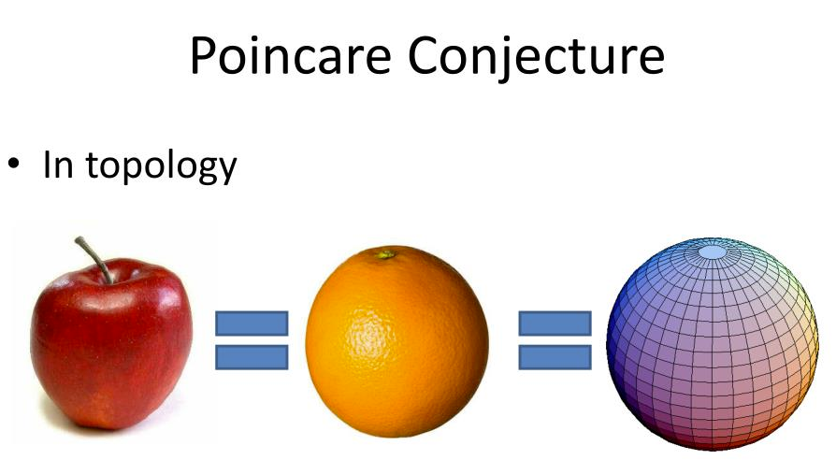
The problem.
Be simple.
Be clear.
Be brief.

Slide 6
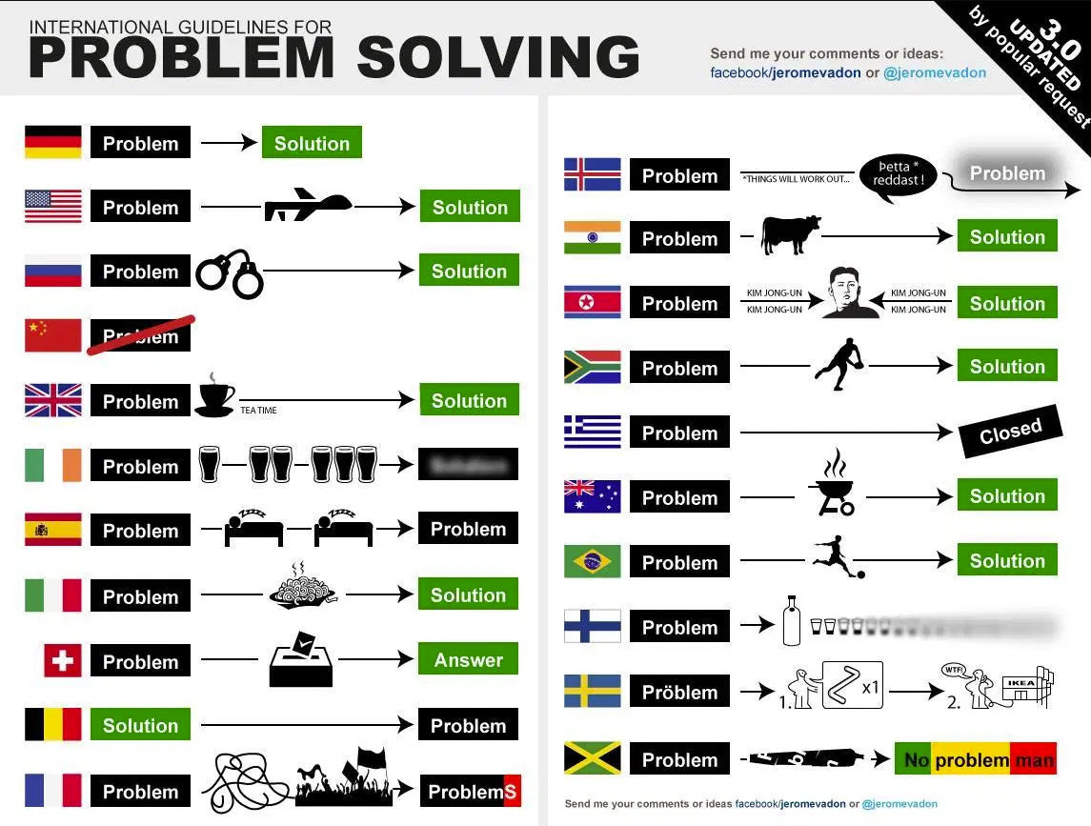
The solution.

Slide 7
The before and after.
No need to fill out this slide, just a place keeper to introduce the second of “before and after” narratives and case studies.

Slide 8
Before situation #1.
Ideally narratives that expose your shortcomings, encounter difficulties, or illuminate key elements of the solution.

Slide 9
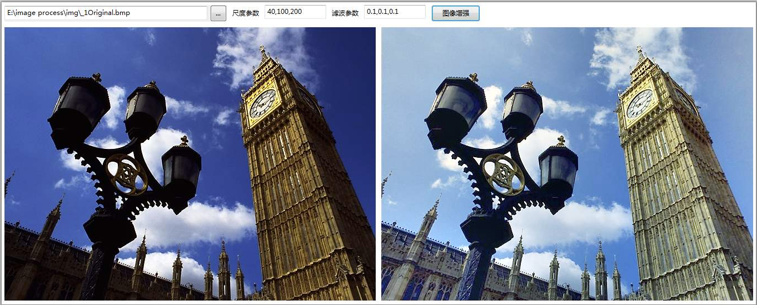
After situation #1.
Before and after language for comparison.

Slide 10
Before situation #2.

Slide 11
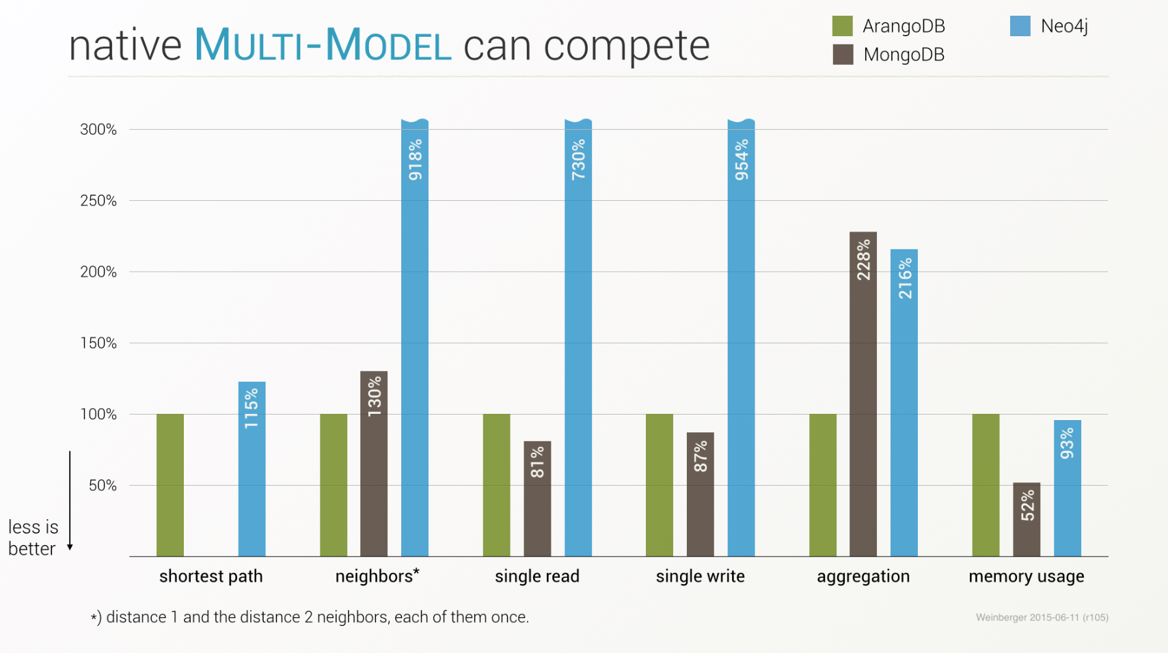
After situation #2.

Slide 12
Before situation #3.

Slide 13
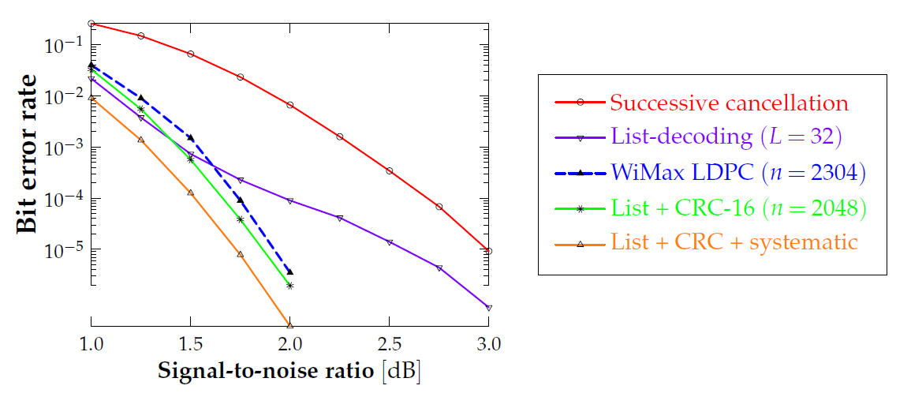
After situation #3.

Slide 14



What you can do to further improve.

Slide 15
The mistakes people make.
Too many words on slides.
Bad color choices.
Unclear motivation.
No comparison.
Too technical.
Too long story.

Slide 16
Your Q and A Slide
YourURL.com/Conference
Your Email

Slide 17
About Oral Presentation:
Choosing your topic
•Choose a topic you find interesting; however, it should be related to the technical content on this course
•For example, you can choose a paper in a relevant topic and explain the main contents of the paper in your presentation
•Format of the presentation •The presentation schedule will be after the Labour Day. (Maybe 1 week later) •Use PowerPoint (or something similar) to make the slides.
The first step here is to submit the PPT file of your presentation. Please also notice all of your team members on the first page and in the file name.

Slide 18
Topics
Artificial intelligence area, such as machine learning, deep learning, deep neural networks, adversarial machine learning, using machine learning for objective quality assessment, deep learning based image style transfer, big data, recommender system, image recognition
Multimedia area, such as image processing, subjective assessment of image and video quality, subjective assessment of audio quality, objective image and video quality metrics
Network area, such as computer networks, software defined networking, block chains security
IoT area, such as IoT applications, communications in IoT, networking in IoT, Ai in IoT, IoT security.
Other specific areas, such as mobile crowd sensing, mobile edge computing, sharing economy, information theory, coding theory.

